Slide 1
Batch 42
Tanzeem Nayaz Ahmed

Slide 2
Problem Statement
Classification of target variable into 0 and 1
where
0 - Company will go Bankrupt
1 - Company will sustain
Approaches taken
Logistic regression
Random Forest
XG Boost
KNN
Decision Trees

Slide 3
Data Exploration
28569 observations of 64 predictor variables, 1 target target variables and 1 ID
Class Imbalance Problem
- 0’s 27183
- 1’s 1386
NA Values
- Most Attributes have >2% NA Values.
- The below mentioned Attributes have a higher
percentage.
Attr37 44.03374287 Attr21 13.55315202
Attr27 6.43004655 Attr60 4.99492457
Attr45 4.98442368

Slide 4
- NA’s across Attr37 have a corresponding value of 0 across
Attr59. Implies Long-Term Liabilities undeclared.
- Sum of NA’s across rows introduced as a new row(na_count) before
Imputing.(Impacted Accuracy by about 8%)
Duplicate Rows
- Attribute 14 and 18 are exactly same as Attribute 7
Highly Collinear Attributes
- Upto 99% between some attributes

Slide 5
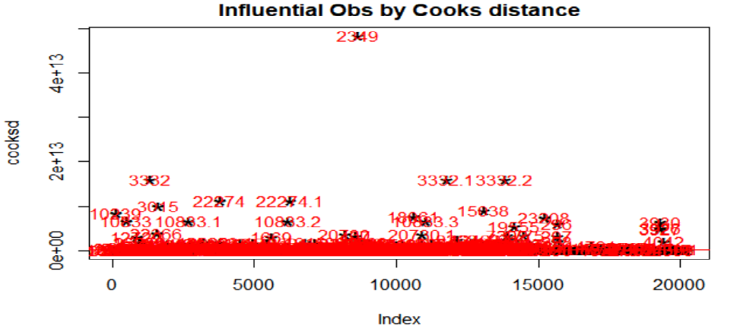
Outliers Observed
- Removed using Cooks Distance but not much improvement in the
model

Slide 6
Data Pre-Processing
Duplicate Attributes removed
NA’s Imputed using KNN method
Influential Points removed using Cook’s Distance but the model worked well when retained.
Collinear Attributes removed in an iterative process.
Class Imbalance handled using SMOTE after removing Collinear Attributes.
Class Imbalance Problem was handled using ROSE in another approach

Slide 7
Model Building
Steps Taken
Split the data into train(70) and validation(30)
Built a Base Model using Logistic Regression with all the attributes
Accuracy 6.95%
Precision=23.21429% and Recall=4.08805%
-All variables are significant due to Collinearity (img in slide8)
Ran VIF on the built model to check VIF. (img in slide 9)
Removed all variables having VIF greater than 10 and built the model.
Accuracy - 10.53%
Precision=15.92357% and Recall=7.861635%
Ran stepAIC
Did not help much.

Slide 8
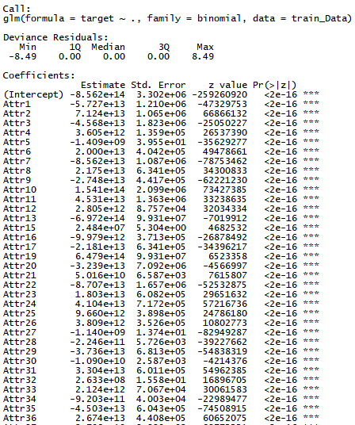
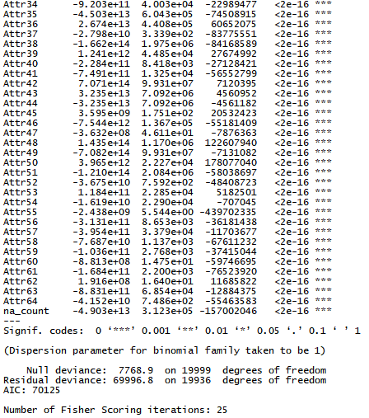

Slide 9
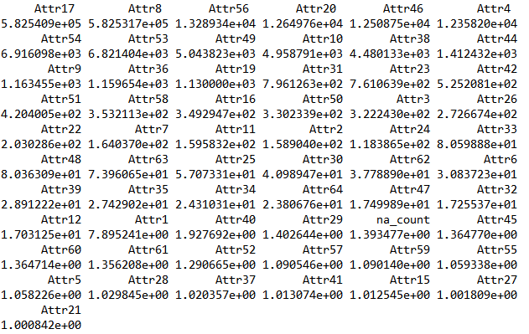

Slide 10
Built a Random Forest to check Variable Importance.
Employed an Iterative process to remove Collinear attributes
- Select 5 Variables with highest VIF
- Check their Importance using Random Forest
- See their individual corelation with other variables
- See their importance in the business sense.
- Eliminate after going through all the above
observations
Important observation
- Some variables with very high VIF had the highest
importance. Retaining them and removing other lesser
important variables causing linearity, helped improve
Model accuracy.
- The VIF keeps changing drastically on the removal of each
attribute

Slide 11
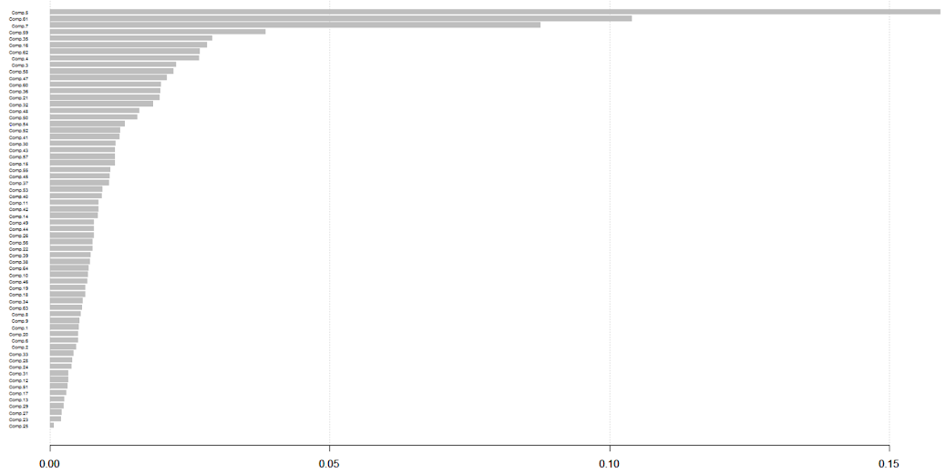

Slide 12
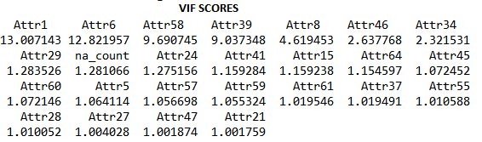
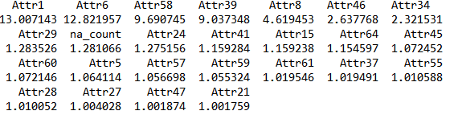
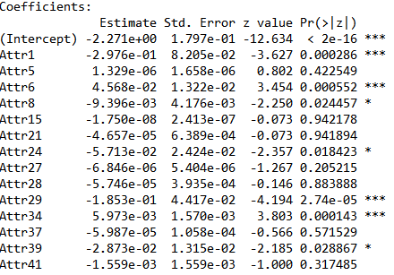
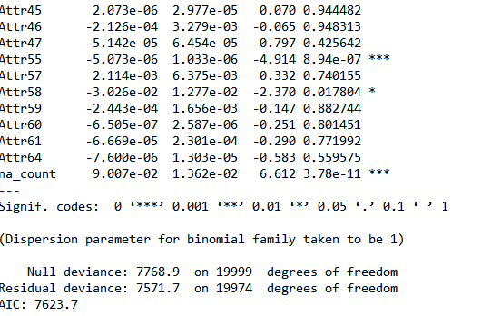
Finalised 23 variables with not much interdependency

Slide 13






The Accuracy improved due to removal of Collinearity.
Model Built using Random Forest.
The Class Imbalance Problem handled using Smote.
Accuracy - 24.86%
Precision=88.46154% and Recall=14.46541%

Slide 14
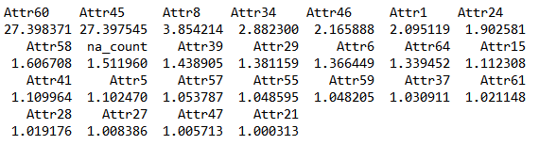
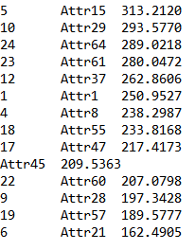
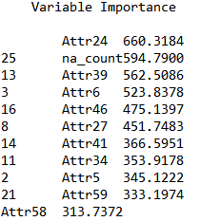
After Removing Mulitcolinearity and balancing the classes, Random Forest model gave the below result
Accuracy is 53.63%
Precision=53.79747% and Recall=53.45912%

Slide 15
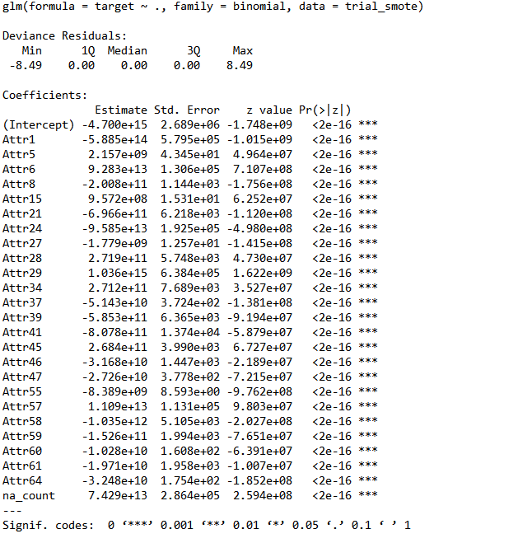

Slide 16

What else was tried?
XG Boost was applied on the balanced dataset .
KNN
Accuracy – 16.14%,Precision – 9.3%,Recall – 60%
Decision Trees
Accuracy – 48%,Precision- 36%,Recall-70%
PCA on selective columns.

Slide 17
What could have been done?
Feature Engineering
A more detailed study on NA’s
Tuned the model with respect to XGBoost
Stacking

